Slide 1

Git and GitHub / GitLab
Sushil Shrestha

Slide 2
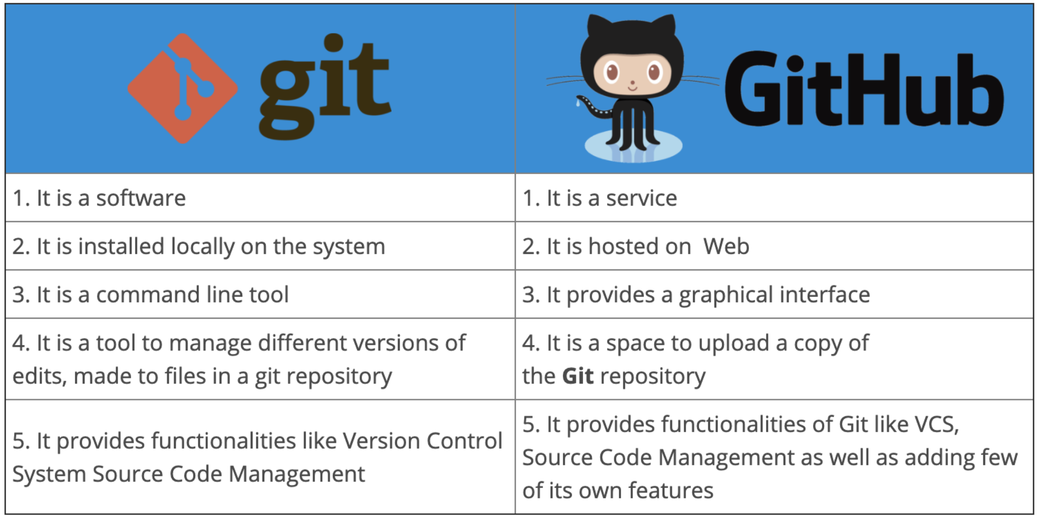

Slide 3
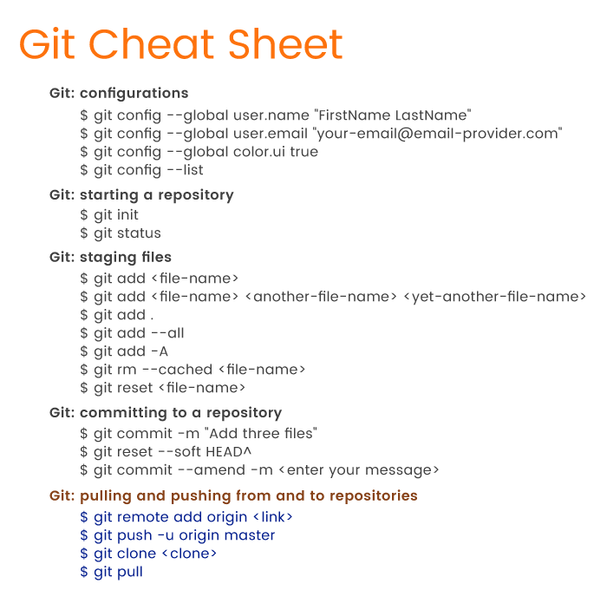

Slide 5
Thank You So Much

